Slide 1
How to Fail at Agile: Common mistakes we all make joelhrobinson@gmail.com
60 second Tutorials
Project Manager
Product Owner
Scrum Master
Development Team
Daily Standup
Product backlog
Reviews & Retrospectives
Kanban

Slide 2
60 Second Tutorial #1 Agile Origins
Manifesto for Agile Software Development
We favor:
Individuals and Interactions over processes and tools
Customer Collaboration over contract negotiation
Responding to Change over following a plan
Working Software over comprehensive documentation

Slide 3
60 Second Tutorial #2 Agile software development
Agile software development describes an approach in which requirements and solutions evolve through the collaborative effort of self-organizing and cross-functional teams and their customers & end users.
Agile advocates adaptive planning, evolutionary development, early delivery, and continual improvement, and it encourages rapid and flexible responses to change. (wikipedia)
Agile approaches are iterative and incremental.

Slide 4
60 Second Tutorial #3 Types of Agile Implementations
Scrum A framework where people can address complex adaptive problems based on team collaboration. very high level plan for multiple sprints to reach release goals
Kanban a method of managing products/tasks with emphasis on continual delivery while limiting work in progress. Japanese for Bulletin board
Extreme Programming a SW development methodology pair programming, avoiding unnecessary work, frequent releases, and constant customer contact.

Slide 5
60 Second Tutorial #4 Scrum Events
Release Planning A high level plan for multiple sprints to reach release goals
Sprint Planning a collaborative effort of the scrum team (scrum master, product owner and dev team) to define the work and effort of the coming sprint.
Sprint a time-boxed period of a development
Sprint Demo a demonstration of development to stakeholders and management to elicit feedback Sprint Retrospective a process improvement meeting

Slide 6
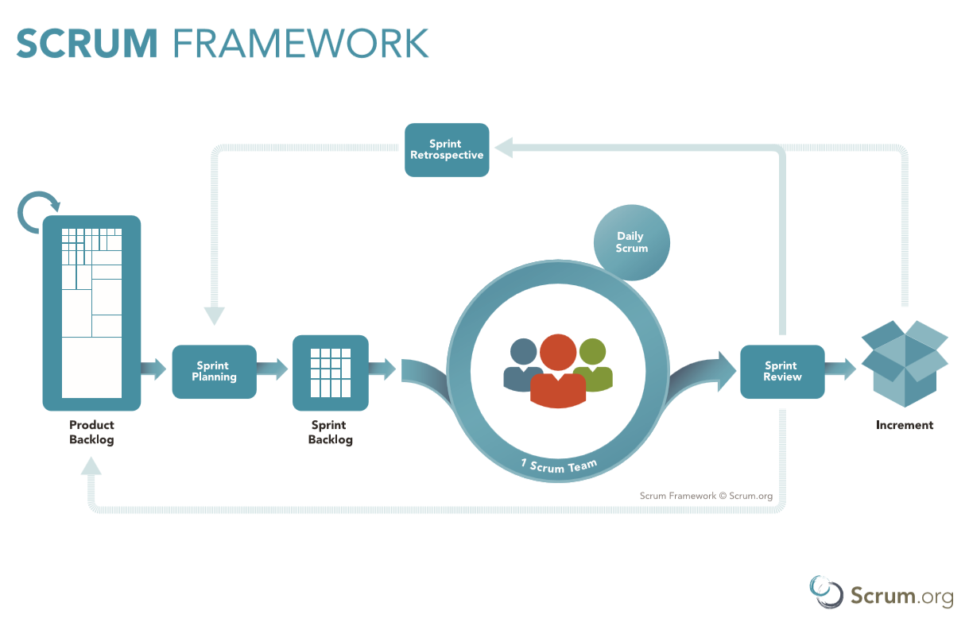

Slide 7
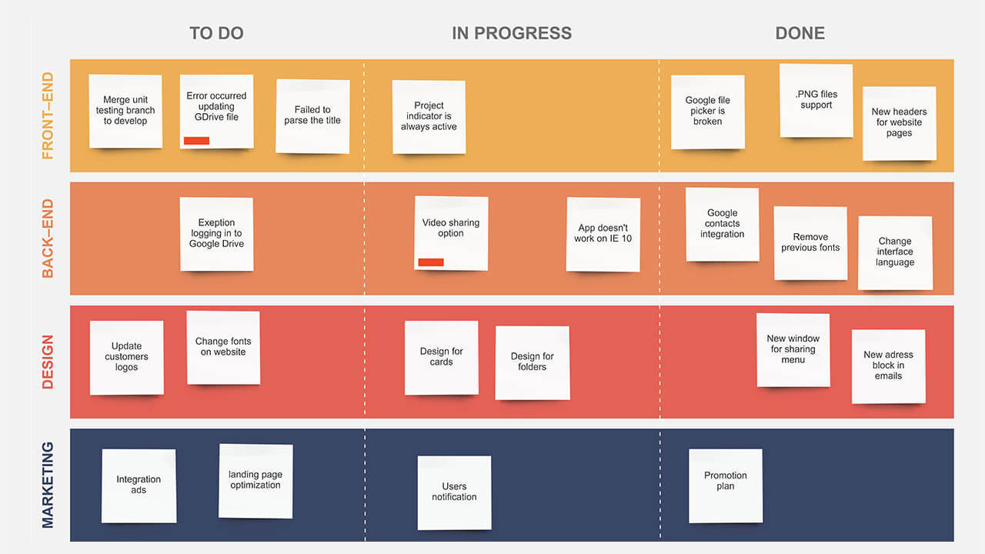
Kanban Board

Slide 8
Agile Project Manager
Does Scrum need a project manger?
How does it work at your company?
Agile team needs someone to escalate issues to.
Someone needs to handle traditional management functions, negotiate contracts and budgets, authorize travel, offices, etc.
Someone needs to work with HR to hire, fire, promote, transfer, replace.
Can teams self-organize, self govern

Slide 9
Agile Projects: Product Owner
Responsible for maximizing the value of the product.
Responsible and accountable for the end product.
Responsible for product releases and sprint plans
Represents the interests of the customers
Maintains & prioritizes the product backlog
Approves product increments & releases releases

Slide 10
Product Owner Issues
Not a project manager / dev manager
Can’t hire and fire dev team members
Can’t assign tasks to dev team
Can’t direct or interfere with dev team
Can’t change priorities /tasks in middle of a sprint
Demos that fail
Team velocity lower than expected
Customer changing requirements
Customer prioritizations (all #1 / must have)
Conflicting customer requirements

Slide 11
Agile Projects: Scrum Master
Coaches dev team and product owner in agile / scrum
Facilitates scrum events & ceremonies
Helps dev team update Scrum artifacts
Creates Scrum artifacts, burn down charts, information radiators
Can be a development team member
Resolves impediments of dev team
Defends team from interruptions & distractions
Coordinates with other scrum teams

Slide 12
Problems being a Scrum Master
Management expects SM to manage the dev team
Dev team expects SM to manage the team
Dev team gives SM status reports
SM can’t prioritize user stories and tasks
Demos that fail
Recalcitrant retrospectives
Missing dev team members
Management interference

Slide 13
Agile Projects: Dev Team
Cross Functional – able to complete all sprint tasks
Highly motivated – ready to accomplish the goals of the product and sprint
Responsible – select, own, and complete tasks
Self-managing – collaborative team effort
Transparent – present impediments
Adaptable – constant improvements
Accountable – commit to complete sprint goals
T-shaped (one speciality + broad abilities)
Coached in Agile / scrum

Slide 14
Development Team Issues
Changing requirements mid sprint
Not have necessary skills
Unresolved impediments
Forced velocity
Failing to meet sprint goals
Skipping scrum events
Not transparent – code inspections
Not collaborative
Expecting daily direction
Holding on to titles and roles
Failing to meet definition of done
Estimating poorly
Not wanting to do scrum/agile

Slide 15
Daily Standup (Scrum & Kanban)
Time boxed 15 minutes
Only the Dev team talks
One person talking at a time
Same time Same place every day
Come prepared answer 3 questions
Arrive on-time, start on-time
Not a status report to management

Slide 16
Daily Standup Issues
Meeting goes long
Becomes a status meeting
Talking Chickens
Interruptions, side talk, monologues
Moved meetings
Devs unprepared
Missing Pigs
Managers assign tasks

Slide 17
Product Backlog
Product owner works with customer to create a product backlog.
Epics are decomposed to stories, stories into sprint items.
User Stories As user ___ I want to ___ so that ___ benefit__
Items should be detailed, emergent (current) estimated, and prioritized. [DEEP]
Items should be Independent of other items, negotiated with the customer, valuable to the customer, estimated, small, and testable. [INVEST]

Slide 18
Product Backlog Issues
Items not Detailed
Items not Estimated
Items not Emergent (stale)
Items not prioritized correctly
Stories not Independent
Items not valuable to end user
Items too big for a sprint
Items missing acceptance / test criteria
Dev team not involved in story grooming/refinement

Slide 19
Reviews and Retrospectives
A Sprint review is a demo of the sprint code by the development team at the end of the sprint to the product owner, customers, and stakeholders
A Sprint retrospective is a meeting after a sprint to evaluate what went wrong, what went well, and how can the team do better.

Slide 20
Review and Retrospective Issues
Review
Failed Demos
Items not completed
New Requirements
Items not tested
Missing stakeholders
Retrospective
Non-participation
Not adapting / improving
Not adding suggestions to backlog or sprint plan
Management attending

Slide 21
Kanban Teams
A Kanban board is a physical / electronic display of tasks moving through the development team.
Developers pull tasks from backlog.
Tasks pass through states until done / deployed
Prioritized tasks are taken from a to-do list and worked on until complete. There is not sprint.
Work in Progress (WIP) Only a certain #of tasks can be in one state
Tasks with highest priorities must be ready to work details, priority, acceptance criteria.
Teams “swarm” on difficult tasks to move them along
Time-box: daily scrum yes, sprint cycles no, product demos held when code is ready, sprint planning and retrospectives as needed
Incremental and iterative

Slide 22
Kanban Board

Slide 23
Kanban Issues
Failing to abide by WIP limits
Not updating board
Board not reflect reality
Tasks piling up in test or dev/ops
Tasks too big, get ‘stuck’
Unresolved bugs
Production support issues interfere with WIP
Items not prioritized

Slide 24
Retrospect this Meeting
Joelhrobinson@gmail.com
www.linkedin.com/in/JoelHenryRobinson

